Slide 1
Russia and Central Asia

Slide 2
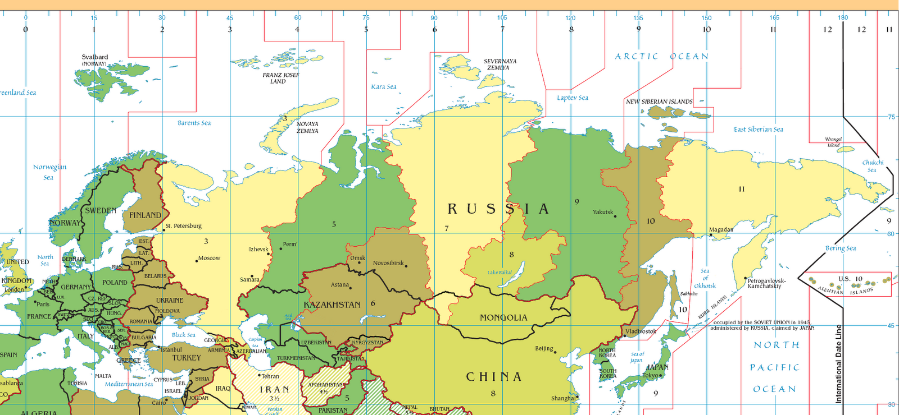
Physical Features
It takes 11 hours to travel by plane from one side of Russia to the other.
World’s largest country
11 time zones

Slide 3
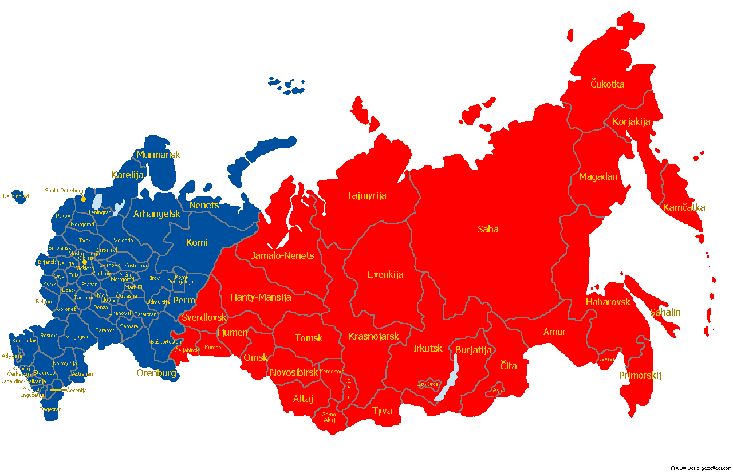
Ural Mountains divide Russia into Europe and Asia
Siberia – Asian part of Russia

Slide 4
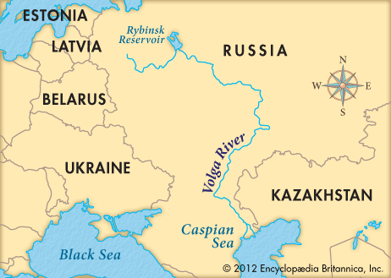
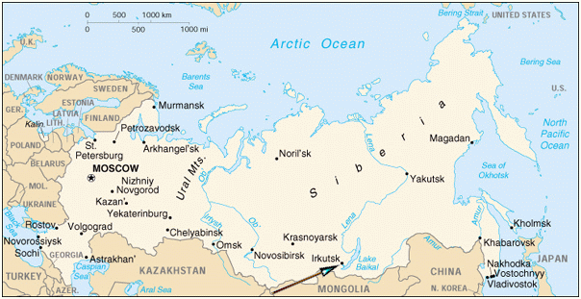
Longest River – Volga
Lake Baikal – one mile deep, holds 20% of the Earth’s fresh water (more than North America and all the Great Lakes combined)

Slide 5
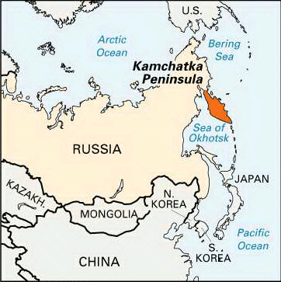
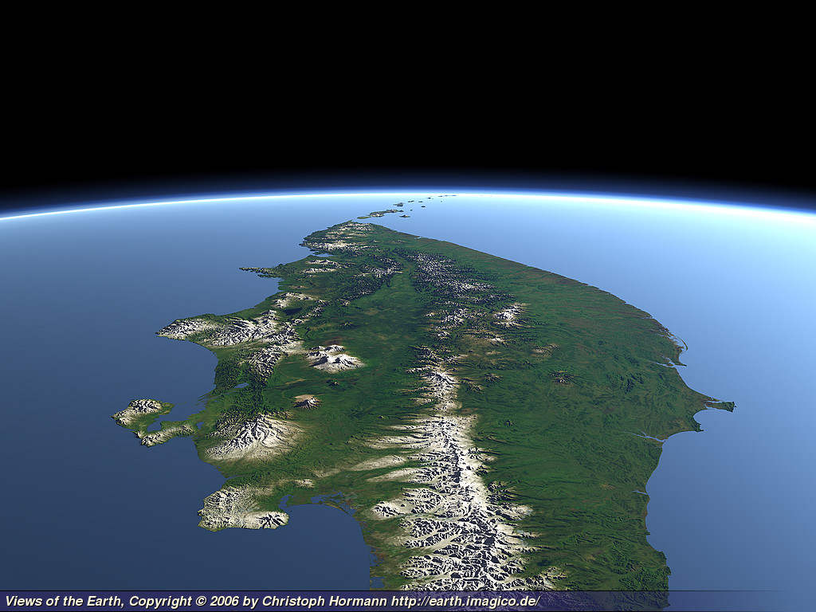
Kamchatka Peninsula – Far East Russia, 160 volcanoes – 29 are active

Slide 6
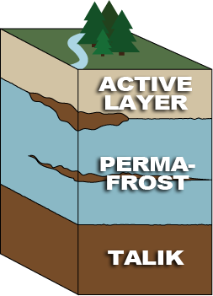
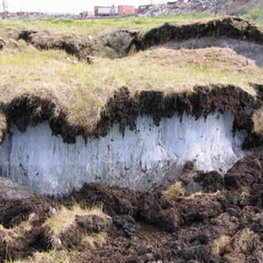
Permafrost – permanently frozen soil in Northern Russia

Slide 7
Natural Resources
Timber, fish, hydroelectric power
1/3 of all of Earth’s coal is in Siberia
Oil, gas – West Siberia
Extensive transportation system

Slide 8
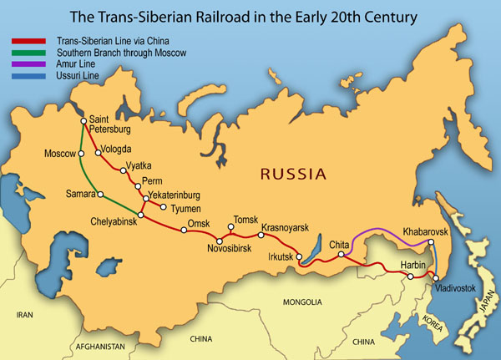
Siberian Railroad
Completed in 1905
Connects Moscow in the west with Vladivostok in the east

Slide 9
Russian People
140 million people
Most live in European part
Siberia is sparsely populated
Most common religion is Eastern Orthodox (Branch of Catholicism)

Slide 10
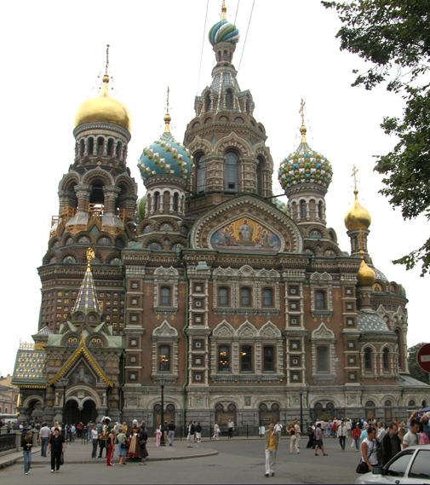
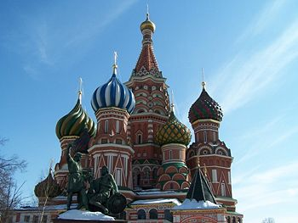
Biggest Cities
Moscow – capital and largest city (10 million people)
St. Petersburg – 2nd largest city

Slide 11
U 9 Q 1
1. How many time zones are in Russia?
2. What is permafrost?
3. List 4 natural resources found in Russia.
4. List 3 facts about population in Russia.
5. What are the 1st and 2nd largest cities in Russia?

